Slide 1
Smart Room
Software Development Project II
CSE 3200

Slide 2
Md. Asaf - Uddowla Golap
Roll - 1207005
Shaikh Akib Shahriyar
Roll - 1207011
Supervised by
Prof. Dr. Md. Aminul Haque Akhand
Department of Computer Science & Engineering
Khulna University of engineering and Technology

Slide 3
CONTENTS
Introduction To Smart Room
A Brief Discussion on how ‘Smart Room’ Works
System Over View
Structure of Smart Room
Limitations
Future Improvements
Conclusion
Control Flow of Android App
Circuit Diagram

Slide 4
Smart Room
Introduction
An Embedded System To control Home Appliances
ON/OFF Light, Fan, Door With a Single Click
Full time Surveillance by IP Camera & Sonar sensor.
Control through Android App/PC Web UI

Slide 5

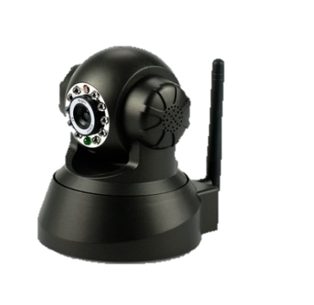
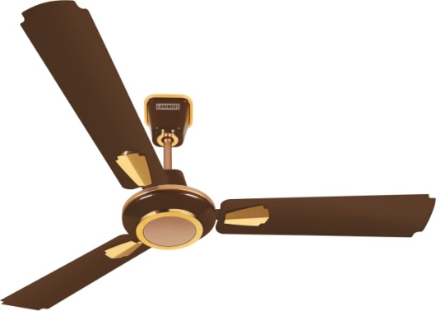

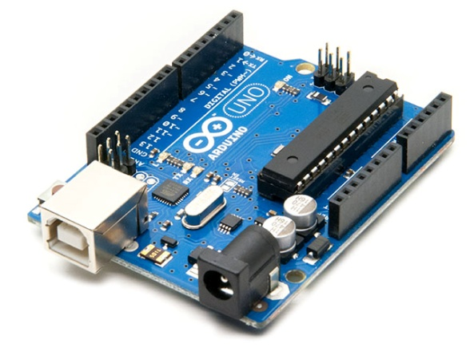
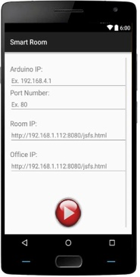
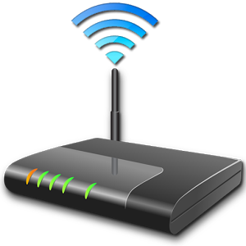


System Overview

Slide 6
CONTENTS
Structure of Smart Room
Smart Room
Hardware
Arduino
Servo Motor
Software
HttpClient
Sonar Sensor
Buzzer
LED
ESP8266
Wifi Module
L293D
6V DC Motor
WebViewClient
AsyncTask
SharedPreferences
Bitmap

Slide 7
TIMELINE
Control Flow Of The Project
Arduino IP
INPUT WINDOW
Home Camera Address
Arduino Port
Door Control Button
LED Bulb Control
MAIN WINDOW
Fan Control Button
Dim Light Control
Watch Live Video Streaming
Live Image Capture

Slide 8
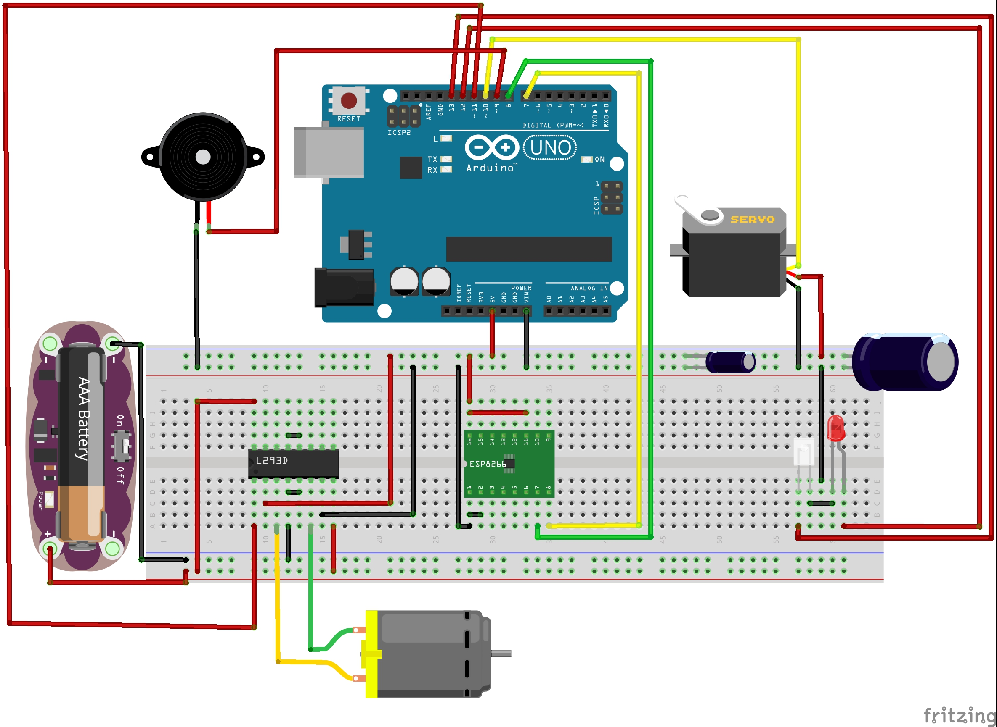

Circuit Diagram

Slide 9
HOW IT WORKS!
A Small Brief on Working Procedure.

Slide 10






WORKFLOW
BUTTON
WIFI MODULE
ARDUINO
ACTION
REPLY
RESULT
Button sends HTTP GET Request to Wi-Fi module
Wi-Fi Module Pass the Request To Arduino through TX-RX Pin
Arduino determines the action
Execute the requested operation
Send a reply to app Via the Wi-Fi module
Appliance ON/OFF

Slide 11
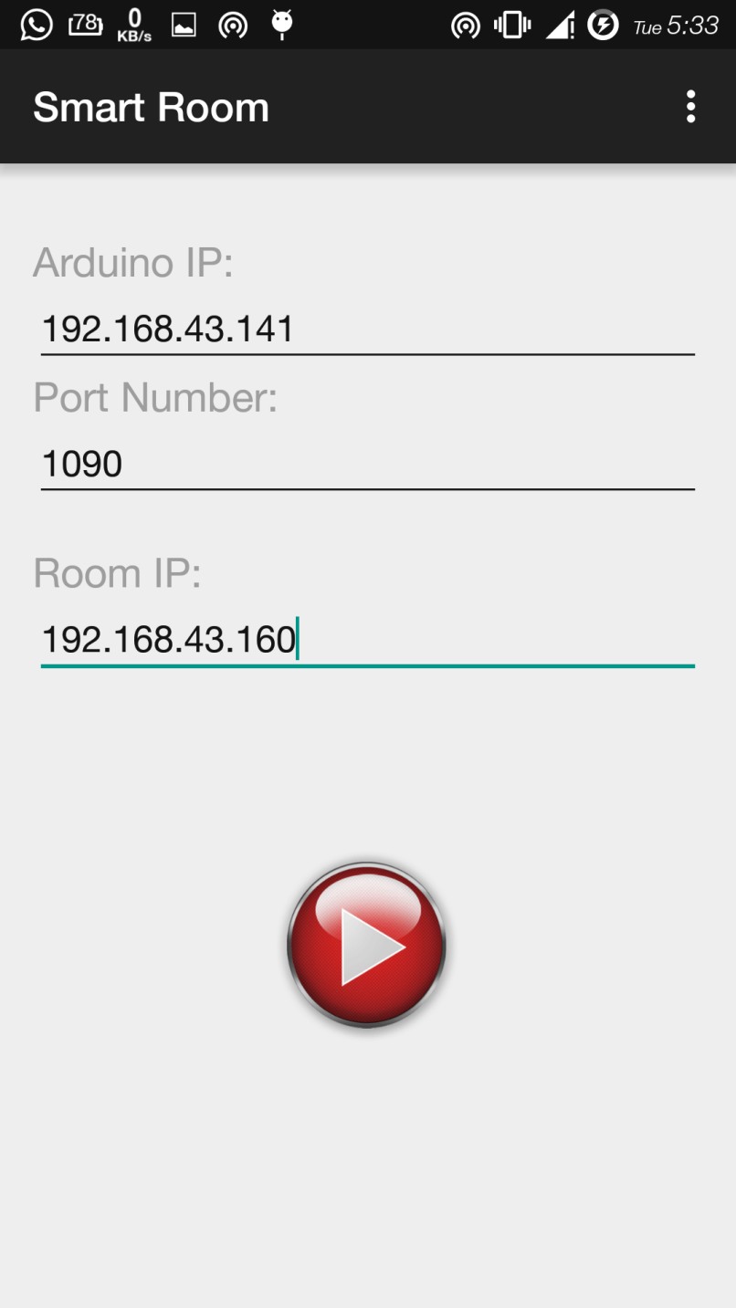
Smart Room : App
Arduino IP
The IP address of the Wi-fi module which works as the Arduino IP address , is given inside this field.
Arduino PORT
The port address of the Arduino.
IP Camera Address
Streaming address of the IP camera is taken as a input here.
The input texts are stored into the ‘Shared Preferences’ (cache) of android operating system.

Slide 12
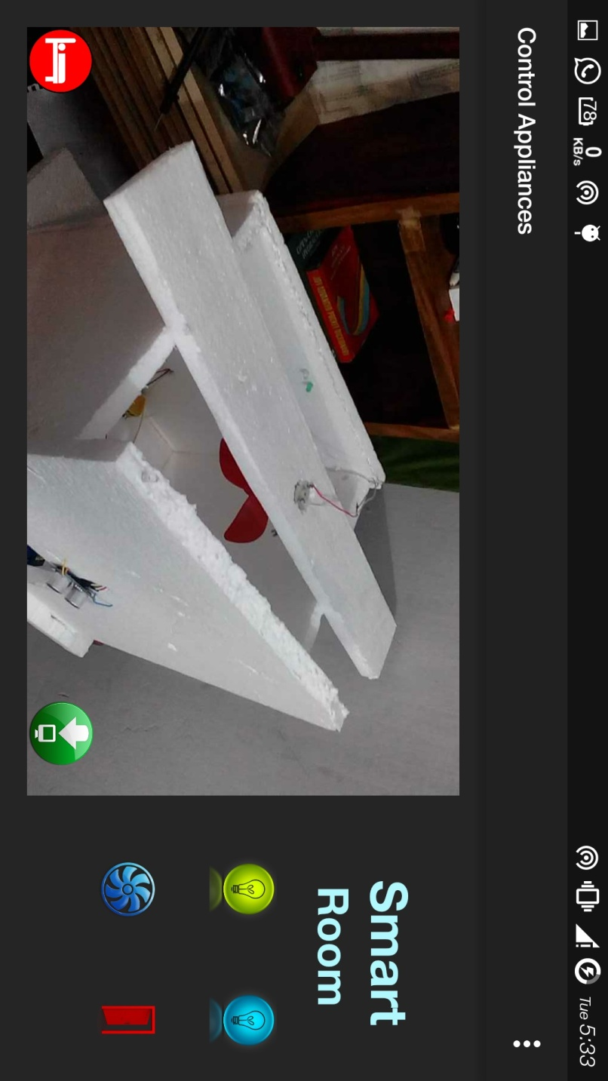
Control Window
Led Bulb Button: controls the led bulb inside the room. If the bulb is already ON, it toggles it to OFF.
.
Fan Control Button: controls the operation of fan. Toggles the state of the fan when the button is clicked.
Web View: displays the live video stream from IP cameras.
Capture Button: can instantly save the live streamed picture into local device storage.
.
Door Control button: controls the movement of the door which can be opened & closed through a simple click on this button.

Slide 13
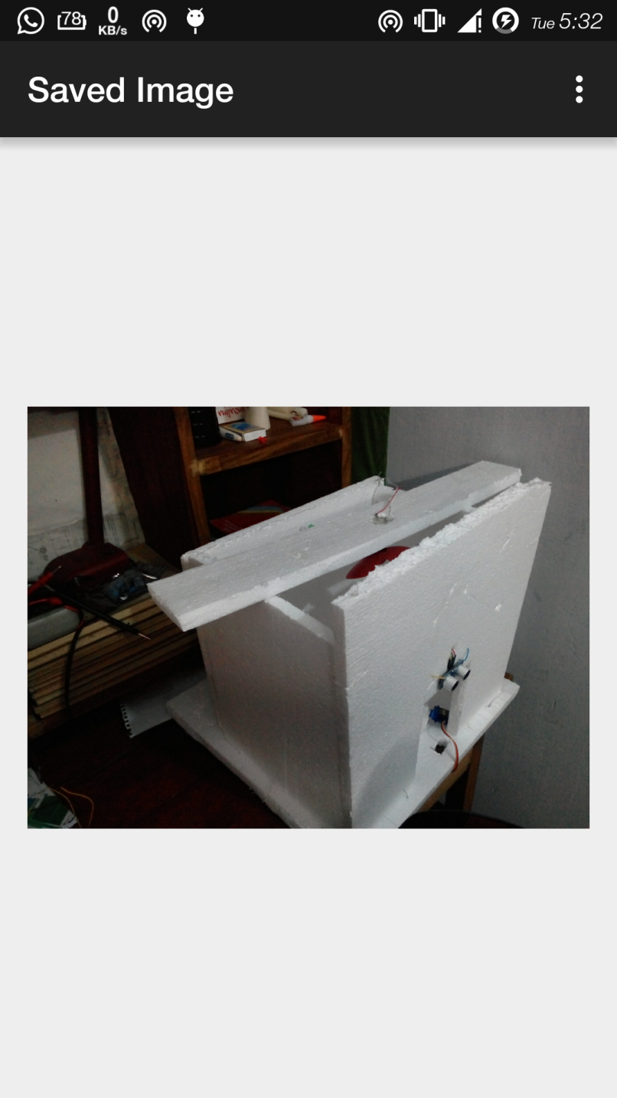
CAPTURE IMAGE
Capture Live image from the IP camera on the go!
The images are stored inside the phone storage.

Slide 14
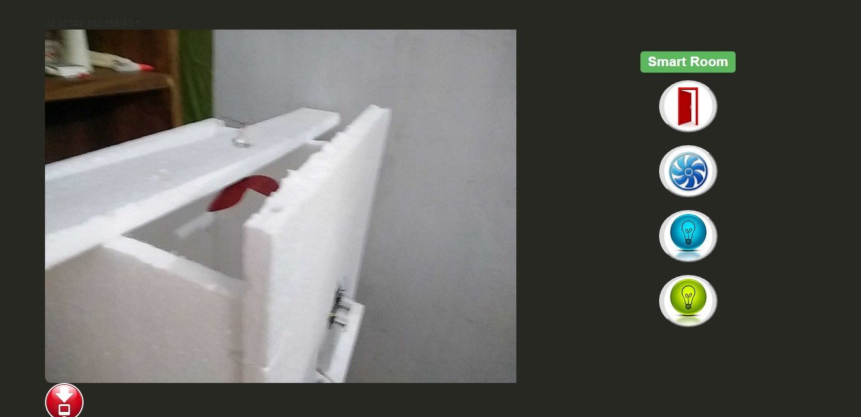
Control From Web UI
‘Smart Room’ can also be controlled from any web browser. The UI of the web are similar to the android companion app.

Slide 15
Stable Power Supply
MISSION 3
Small Delay in Response
MISSION 2
Voltage Fluctuation
LIMITATIONS
MISSION 1
Certain drawbacks occurred during the implementation phase. Working towards overcoming these limitations.

Slide 16
FUTURE
IMPROVEMENT
THIRD STEP
Voice control through NLP
Thief Alert.
FIRST STEP
Wide Area Coverage through Internet.
Allow Remote Access through Cloud Based Solution.
FORTH STEP
Baby Monitoring.
Old Age Monitoring.
Home Atmosphere Control.
SECOND STEP
More Compact Design.
Modularity.

Slide 17


ANYTIME, ANYWHERE
Comfort of controlling room appliances with a single touch from Smartphone/PC/Tab.

Slide 18
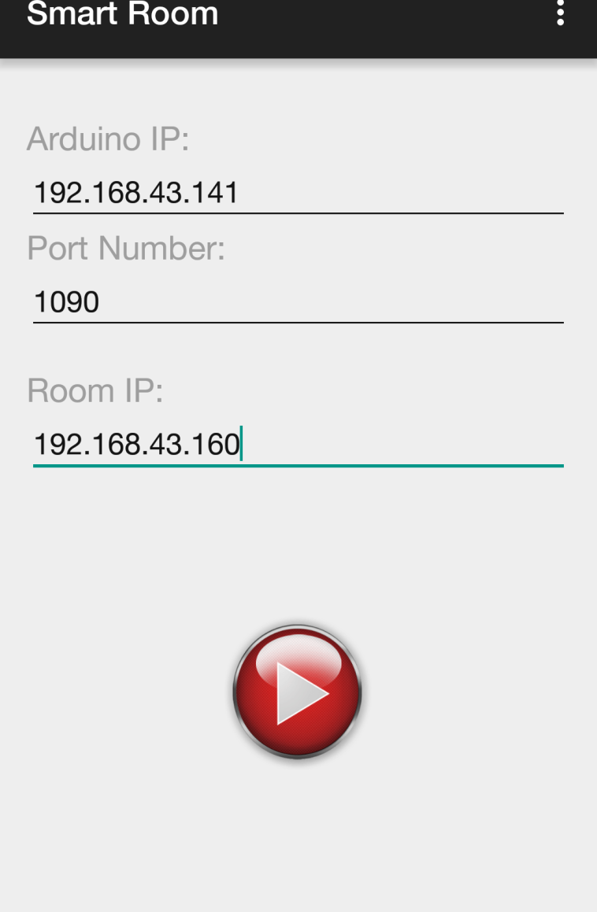
KEEP IMPROVING OUR SYSTEM
From home and away, “Smart Room” makes control simple, with everything you need in a single, elegant app. Continuous development & maintenance is necessary for future improvements.
CONCLUSION
The target user group of this system is increasing day by day. More people are becoming interested in automated system approach.

Slide 19
THANK YOU!
ANY QUESTIONS?

